Slide 1


What’s new?
2 Step NAC Protocol
BC Drug and Poison Information Centre
BC DPIC
Last Updated: 16 Sep 26

Slide 2
Background
    BC DPIC is transitioning to a new, standardized pan-Canadian protocol for management of acetaminophen poisoning with intravenous N-acetylcysteine (NAC)
    BC is changing the N-acetylcysteine protocol to align with the rest of the Canadian Provinces
    The change is in response to safety concerns raised by the Institute for Safe Medication Practices (ISMP) Canada

Slide 3
The traditional 3-step regimen is being replaced by a simplified 1-concentration, 2-step protocol
OLD | NEW
3 Bags Multiple concentrations Complex Dosing | 1 Concentration 2 Steps Standardized Dosing
What is changing?
REVISED PAN CANADA NAC PROTOCOL
1-concentration, 2-step, standardized protocol
3% NAC (30mg/ml)
Step 1: 150mg/kg over 1 hour
Step 2: 15mg/kg/hour continuous infusion for a minimum of 20 hours

Slide 4
    Higher total dose (450mg/kg vs 300mg/kg over 21 hours)
    No ad hoc dose adjustments for massive ingestions or patient on renal replacement therapy
Key Practice Changes
Continuous infusion simplifies administration
    Flexible fluid selection for pediatric patients

Slide 5
The Traditional 3-bag IV NAC regime is complex and has been associated with medication errors. These changes were made for overall patient benefit.
BEFORE
AFTER
    Multiple Preparations
    Inconsistent Protocols
    Dose adjustments
…Overall increase in risk of dosing errors and patient harm
    Improved Patient Safety
    Reduced dosing complexity
    Consistent practice across institutions
    Clearer stopping criteria
    Superior protection for massive overdoses or established liver disease
Rationale

Slide 6
How to Prepare the IV NAC Bags
Protocol for Admixture Volume
Differs based on:
Diluent
Options
D5W (Preferred in Adults)
Final Concentration
NAC 3% (30 mg/ml)*
NS
1/2 NS
*For all methods
Institutional Guidelines
Ie. If 1-Bag or 2-Bag administration method will be chosen
Weight

Slide 7
How to Prepare the IV NAC Bags
IV NAC is Ordered
Institution to guide on method:
1-Bag or 2-Bag
1-Bag Method
2-Bag Method
Mix two Admixture bags
Mix one Admixture bag
#1 Loading Dose bag
#2 Maintenance Infusion bag
The bags could be different volumes but they all have the same concentration (3%)!

Slide 8
Recommendations for Admixture Volume
1-Bag and 2-Bag Method
1-Bag Method
For institutions with programmable smart pumps (automatic switch from loading to maintenance infusion) and using single admixture preparation
2-Bag Method
For institutions using separate admixture for loading dose and maintenance infusion
Patient Weight | Single Admixture Volume
15kg or less | 250mls
16-30kg | 500mls
31-65kg | 1000mls
66-100kg | 1000mls + 500mls
101kg or greater | 1000ml + 500mls
Patient Weight | Loading Dose Admixture Volume | Maintenance Infusion Admixture Volume
15kg or less | 100ml | 250mls
16-30kg | 250mls | 500mls
31-65kg | 500mls | 1000mls
66-100kg | 500mls | 1000mls
101kg or greater | 500mls | 1000mls
In patients >100 kg, use a maximum weight of 100 kg (220 lbs) for dosing.

Slide 9
How to Prepare 3% IV NAC admixture
100 ml Admixture
Remove 15 mL from 100 mL bag
500 ml Admixture
Remove 75 mL from 500 mL bag
1000 ml Admixture
Remove 150 mL from 1000 mL bag
250 ml Admixture
Add 15 mL of 20% IV NAC (200mg/mL) to remaining 85 mL for final volume of 100 mL
Final concentration
3.0 g NAC in 100 mL or 30 mg/mL (3%)
Remove 37.5 mL from 250 mL bag
Add 37.5 mL of 20% IV NAC (200mg/mL) to remaining 212.5 mL for final volume of 250 mL
Final concentration
7.5 g NAC in 250 mL or 30 mg/mL (3%)
Add 75 mL of 20% IV NAC (200mg/mL) to remaining 425 mL for final volume of 500 mL
Final concentration 15 g NAC in 500 mL or 30 mg/mL (3%)
Add 150 mL of 20% IV NAC (200mg/mL) to remaining 850 mL for final volume of 1000 mL
Final concentration 30 g NAC in 1000 mL or 30 mg/mL (3%)

Slide 10
1-Bag Method: How to Administer
For institutions with programmable smart pumps (automatic switch from loading to maintenance infusion and using single admixture preparation
Step 1 - Loading Dose
Step 2 – Maintenance Dose
Reassess if patient meets criteria to Discontinue NAC
15 mg/kg/hour (0.5 mL/kg/hour of 3% NAC solution) for a minimum of 20 hours
150 mg/kg (5 mL/kg of 3% NAC solution) over 1 hour
SIGMA pump must use LOADING dose function to administer initial loading dose
ALARIS pump must use BOLUS dose function to administer initial loading dose

Slide 11
2-Bag Method: How to Administer
For institutions using separate admixture for loading dose and maintenance infusion
Step 1 - Loading Dose
Step 2 – Maintenance Dose
Reassess if patient meets criteria to Discontinue NAC
15 mg/kg/hour (0.5 mL/kg/hour of 3% NAC solution) for a minimum of 20 hours
150 mg/kg (5 mL/kg of 3% NAC solution) over 1 hour
Discard remaining fluid in loading dose bag after the infusion is complete

Slide 12
Discontinuation Criteria
Part I - Lab Work to Order
Near the end of the 21-hour infusion*
The following lab tests should be repeated:
Serum Acetaminophen Level
AST and/or ALT
INR
AND
*Reminder, the patient will need at minimum close to 21 hours of NAC
We advise drawing lab work near the end of the 21-hour infusion to minimize the time gap between the lab work resulting and the infusion ending.
AND

Slide 13
Discontinuation Criteria
Part II - Assessment of Lab Work
N-acetylcysteine can be discontinued if*
Serum acetaminophen level is less than 66 µmol/L
AST and/or ALT is normal for patient or declining (>25% decline from peak)
INR is less than 2.0 and declining (without the influence of fresh frozen plasma)
Patient is clinically well (no encephalopathy
AND
AND
AND
*Contact BC Poison Control Centre regarding discontinuation questions

Slide 14
Discontinuation Criteria
Part III - Failure to Meet Criteria
1
2
NAC is to be continued beyond the 21-hour infusion
3
Patient failed to meet criteria to discontinue NAC
4
Continue 3% NAC solution 15 mg/kg/hour (0.5 mL/kg/hour) indefinitely
Monitor AST, ALT, INR, Serum Acetaminophen every 12 to 24 hours
5
Continue until discontinuation criteria is met
(see previous slide - Part II Assessment of Lab Work)

Slide 15
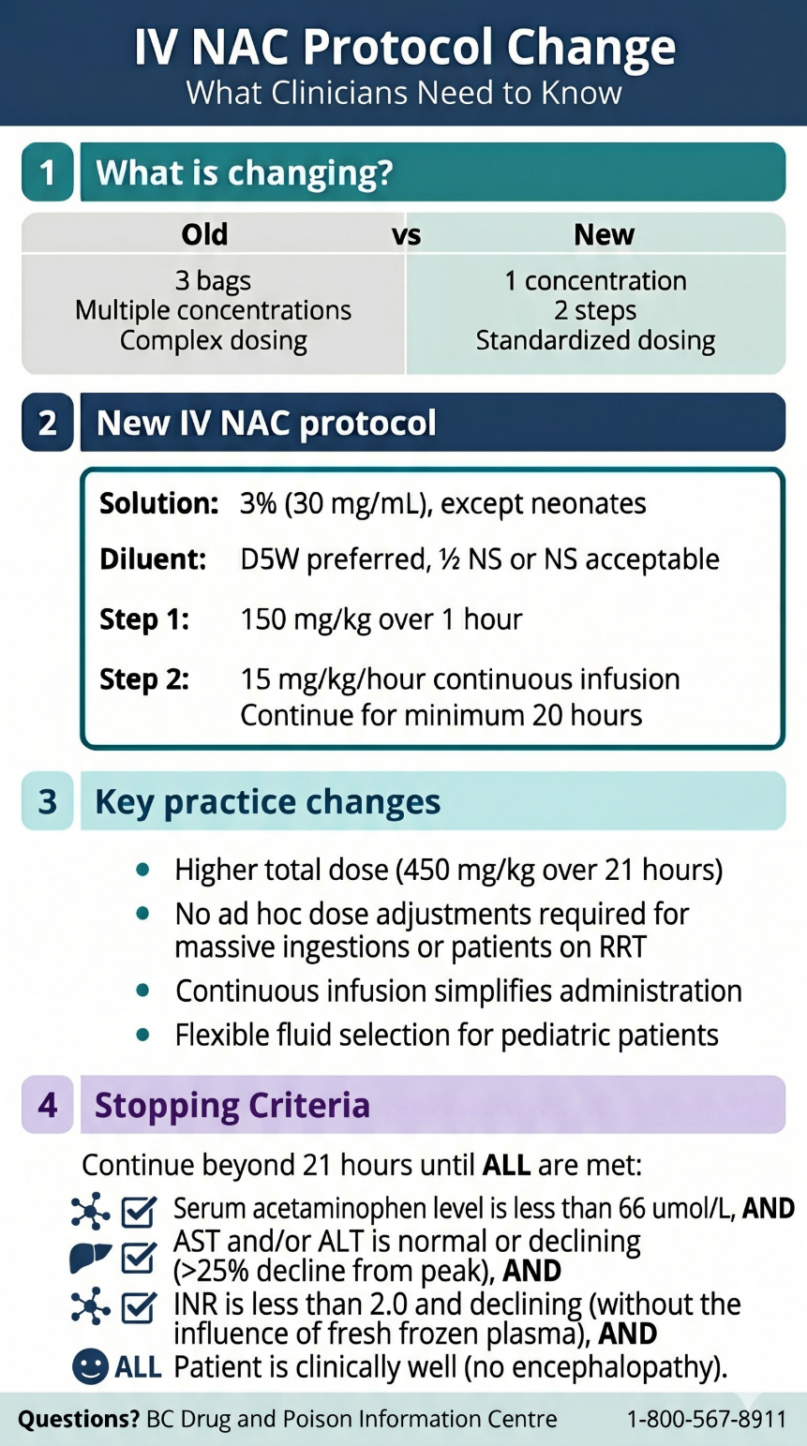
This is a summary infographic that can be posted around your hospital unit or at nursing station

Slide 16
15 September 2026
Island Health will transition to the new protocol
01 November 2026
The rest of the province
Implementation
    Local Resources will need to be aligned with the standardized protocol, for example:
      Order sets
      Infusion references
      Monographs

Slide 17
Questions?
Call BC Drug and Poison Information Centre
604-682-5050
1-800-567-8911

